Slide 1

SREENIDHI INSTITUTE OF SCIENCE AND TECHNOLOGY
YAMNAMPET, GHATKESAR, HYDERABAD, TELANGANA
Group Project
Final seminar
On
Online book exchange
By,
G RAVI TEJA – 14311A0504
N SOUMYA SREE – 14311A0532
GAJAVELLI SRIKAR – 14311A0545
Guide:
K MADHUKAR
(Assistant Professor)
a14

Slide 2


Slide 3


Slide 4
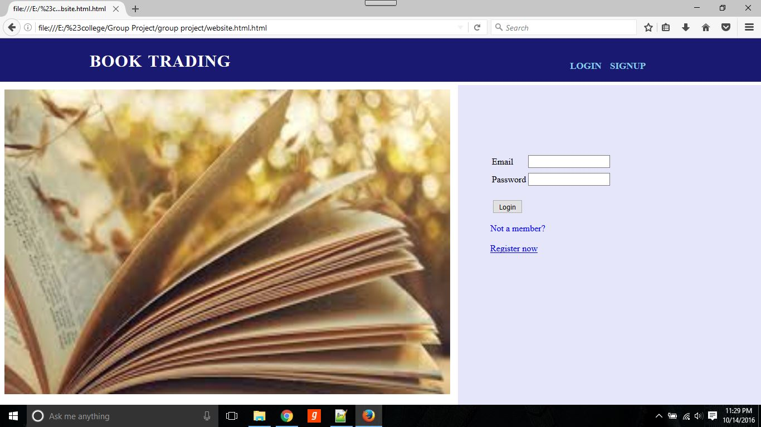

Slide 5
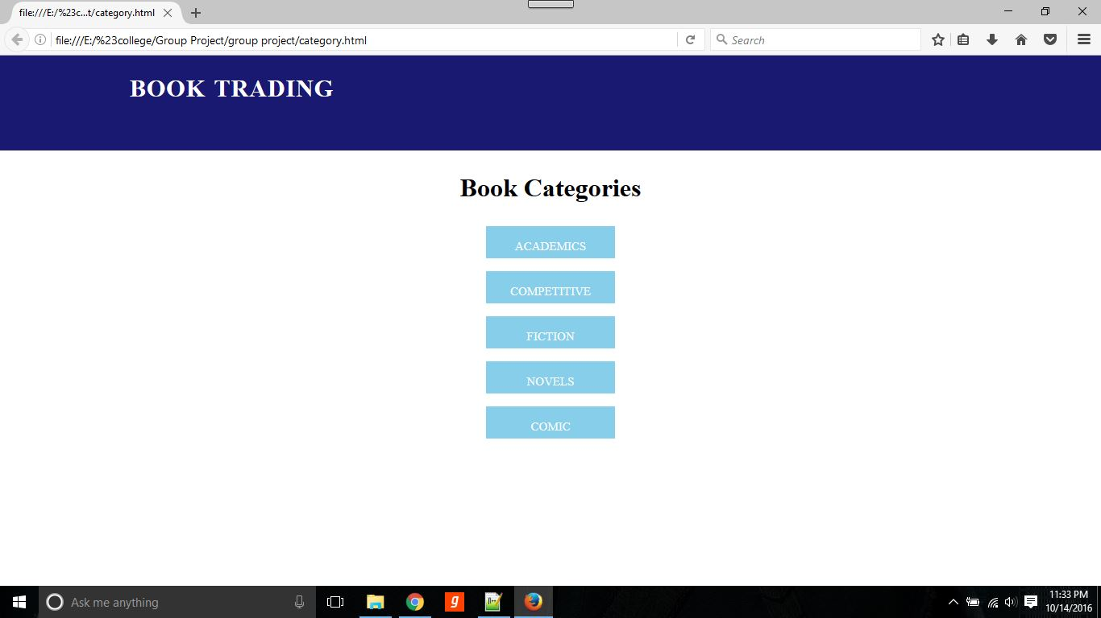

Slide 6
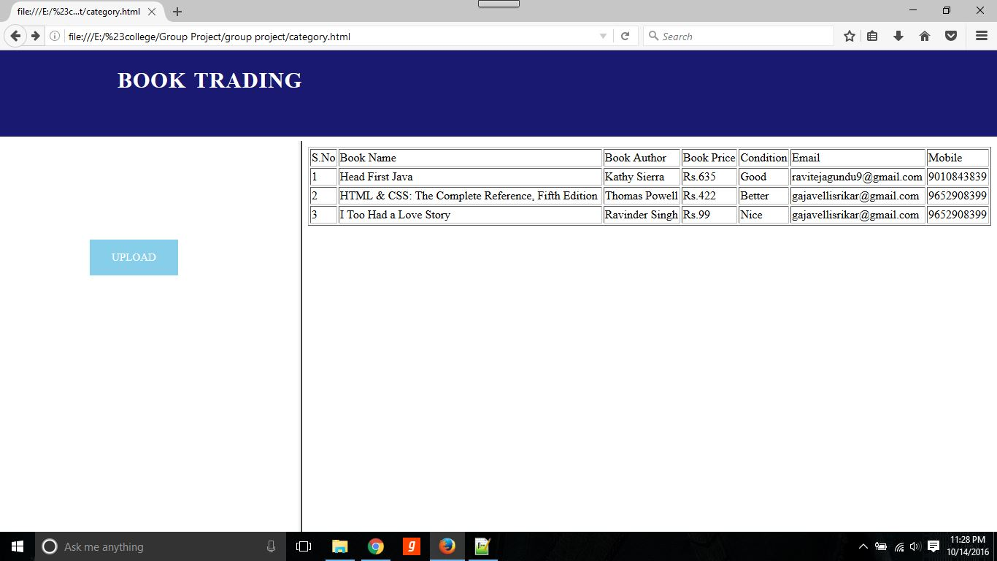

Slide 7
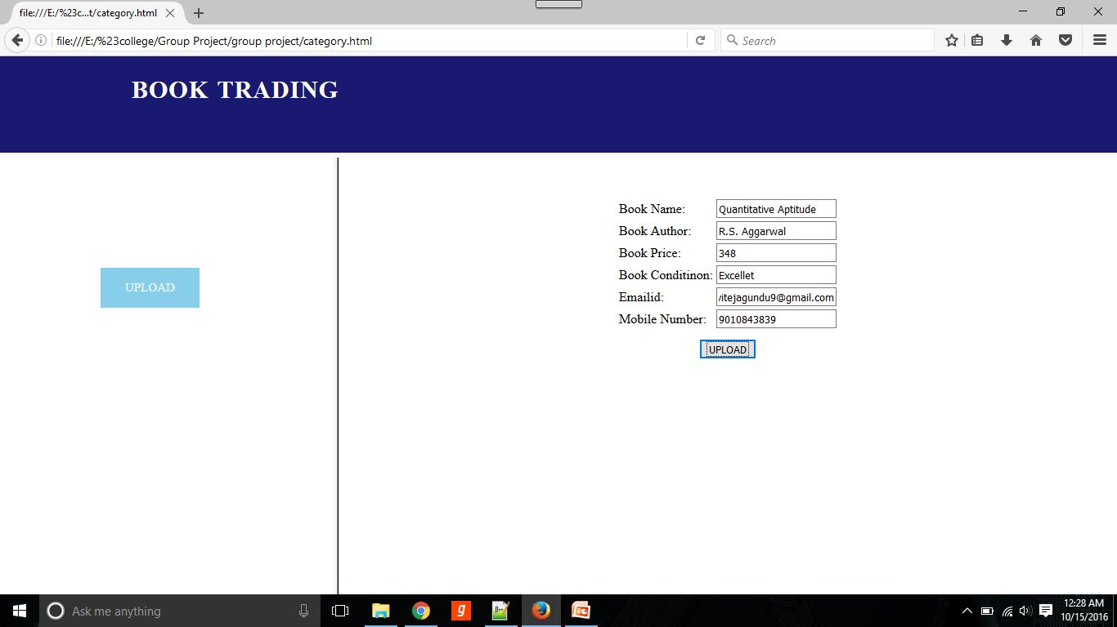

Slide 8
Thankyou
. . .

